Slide 1

INTERVIEW MANAGEMENT SYSTEM

Slide 2
TEAM MEMBERS
Aravindhan Ra ​
Darshana A​
Deepika S​
Gokul P​
Kumaresh K S​
Prithviraj S P​
Remuki J S​
Sheik Fareeth H​
Vinoth J​
Project Duration in Days : 45 days

Slide 3
EXISTING CHALLENGES​
Time Consuming​
Difficult to find availability
Challenging to measure performance

Slide 4
ABOUT THIS APPLICATION
Admin
Manage Location
Manage Role
TAC
Manage Pool
Manage Pool Members
Manage Department
Manage Project
Manage Employee Request
Create Drive
Schedule Drive
Collecting Availability
Interviewer
Gives Availability
Cancel Availability
Management
Gives Availability
Cancel Availability
View their performance
View their performance
View department performance
Notes:
Create drive
Availability of the interviewers

Slide 5
SOLUTION
Easy to collect the availability of the interviewers
Tracking performance
Data is centralized

Slide 6
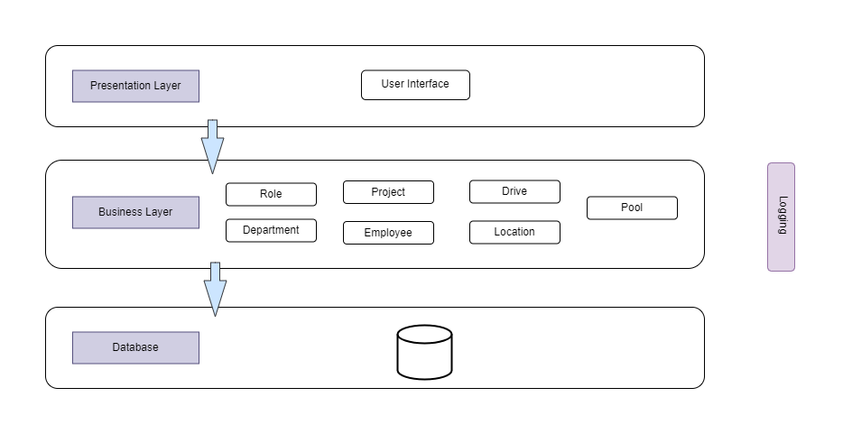
SYSTEM ARCHITECTURE

Slide 7
EXECUTION JOURNEY
Functional and Non-Functional Requirements
User stories​​
Data model
Wireframe​
HTML Template​
High level design
Low level design
Angular Components​
Web API​
Integration​
Unit Testing​
Test scenarios
SonarQube​
JMeter
Linting​
Light House​
Deployment in IIS​
Set-up documentation

Slide 8
ARTIFACTS
Areas​ | Link​
Requirement – User Stories, Wireframes, Data Flow​ | Click Here
Swagger - API​ | Click Here
Data Model – EAR (Entity Attribute Relationship)​ | Click Here
Test Scenarios​ | ​Click Here
Sequence Diagrams​ | Click Here
Defect Logs​ | Click Here
Code Quality Metrics​ | Click Here​
Setup Manual​ | Click Here

Slide 9
TECHNOLOGIES & TOOLS USED
TECHNOLOGIES
TOOLS
Asp Dotnet Core 6.0​
Angular 13​
Node js​​
Entity Framework Core
Visual Studio Code​
Microsoft SQL Server Management Studio
GitHub
Git Desktop
Swagger
SonarQube​
ES Lint
Figma
Jdk​
JMeter​

Slide 10
DEMO
Website : Click Here​
Swagger Documentation : ​Click Here

Slide 11
LEASONS LEARNED
Understand the system end to end.​
Collect the requirements properly.​
Think as an end user while designing a system.​
Don't forget to address Non – Functional Requirements.​
Learned to work as a team with responsibilities.​
Always keep a backup of our work.​
To respect others time in our team.​
To avoid conflicts and to resolve conflicts. ​

Slide 12
To value the customer inputs and make use of it.​
To identify the bugs earlier.​
Never assume.​
Learned how to use testing tools.​
Plan with your team before executing new feature.
Don't hesitate to ask questions.​
Team meetings are always important to track the works.​
Brainstorming is very important to share ideas.​
Always update MOM to track the meeting updates.
“Time sheet is the mirror for your career growth.”

Slide 13

THANK YOU ☺

